Slide 1
Learning Hierarchical Features for Scene Labeling
Cle’ment Farabet, Camille Couprie, Laurent Najman, and Yann LeCun
by Dong Nie

Slide 2
Outline
Background/Motivation
Multiscale CNN for feature representation and initial classification
Postprocessing: Graph-based classification
Majority over super-pixel regions
CRF over superpixels
Optimal cover of purity tree
Experimental Results
Discussion

Slide 3
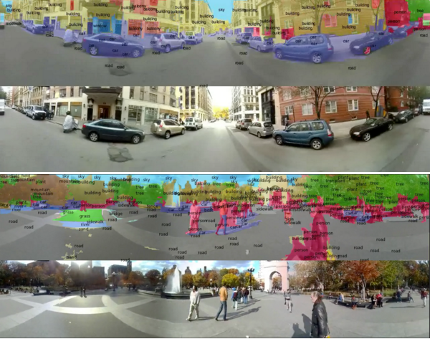
Scene parsing/labeling: definition
Scene parsing: labeling each pixel in the image with category of the object to which it belongs
Scene parsing is one important step toward image understanding

Slide 4
Questions for scene parsing
How to produce a good internal representation of the visual information?
How to use contextual information to ensure the self-consistency of the interpretation ?
Or end-to-end scene parsing

Slide 5
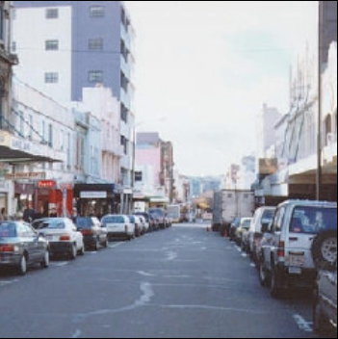
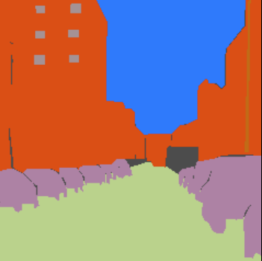
Scene Parsing: conventional methods
Most scene parsing methods based on graph model
Presegmentation (superpixels/segment candidates)
CRFs/MRFs ensure consistency of labeling
window
tree
sky
road
field
car
building
unlabeled
http://people.csail.mit.edu/celiu/pdfs/LabelTransferTPAMI.pdf

Slide 6
Proposed method
Scene Parsing Architecture of this system relies on two main components
Multiscale deep feature representation
Graph model based classification
Superpixels
CRF over superpixels
Multilevel cut with purity tree

Slide 7
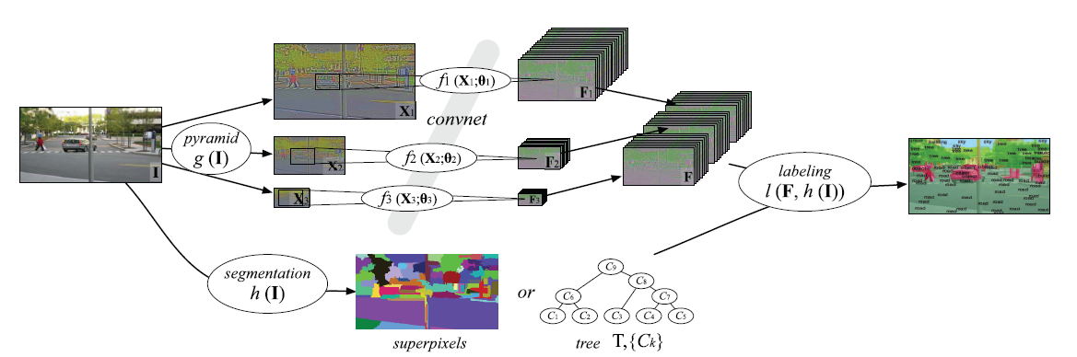
Proposed method
CRF

Slide 8
Outline
Background/Motivation
Multiscale CNN for feature representation and initial classification
Postprocessing stratigies: Graph-based classification
Majority over super-pixel regions
CRF over superpixels
Optimal cover of purity tree
Experimental Results
Discussion

Slide 9
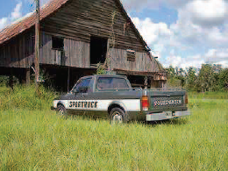
Multiscale feature representation for scene parsing
Good internel representations are hierarchical
CNNs are capable to learn such hierarchies of features
Multiscale strategy is adopted to combine short-range and long-range information

Slide 10
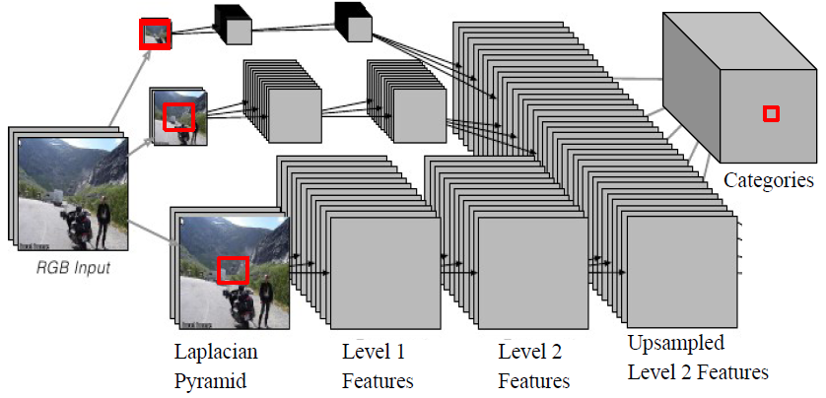
Multiscale CNN for scene parsing
Notes:
Each output sees a large input context:
46x46 window at full rez; 92x92 at . rez; 184x184 at . rez
[7x7conv]->[2x2pool]->[7x7conv]->[2x2pool]->[7x7conv]->
Trained supervised on fully-labeled images

Slide 11
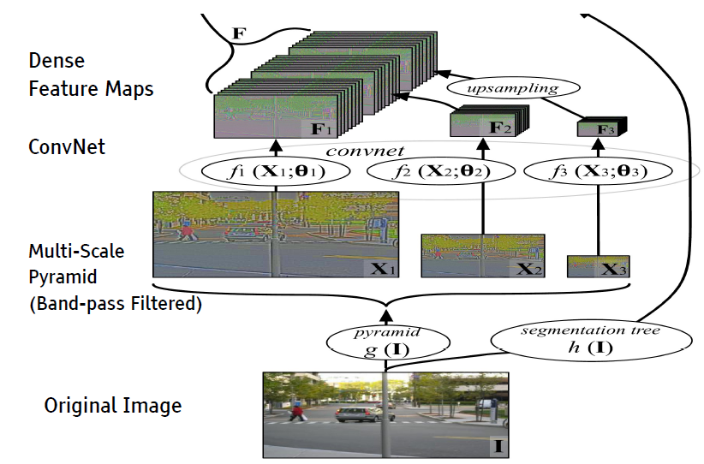
Multiscale CNN for feature representation
Notes:
1. Bank of images as 3D arrays
2. The maps of the pyramid computed using scaling/normalization function: gs, Xs=gs( I ), ∀s∈1,... , N
3. For network fs with L layers where the vector of hidden units at layer l is fs( Xs ;θs)=WLH(L−1)
where the vector of hidden units at layer l is a result from a stream of convolution and pooling operations
4. The outputs of the N networks – unsampled und concatenated so as to produce F , where is an upsampling function

Slide 12
Outline
Background/Motivation
Multiscale CNN for feature representation and initial classification
Postprocessing: Graph-based classification
Majority over super-pixel regions
CRF over superpixels
Optimal cover of purity tree
Experimental Results
Discussion

Slide 13
Superpixel methods
Graph based method
Graph based
by Felzenszwalb et al.
Ncut (normalized cut)
by Shi et al.
Superpixel
Generation
Superpixel lattice
by Moore et al.
Entropy based
by Liu et al.
Gradient descent based method
Watersheds
by Vincent et al.
Mean shift
by Comaniciu et al.
Quick shift
by Vedaldi et al.
Turbopixels
by Levinshtein et al.
SLIC
by Achanta et al.

Slide 14
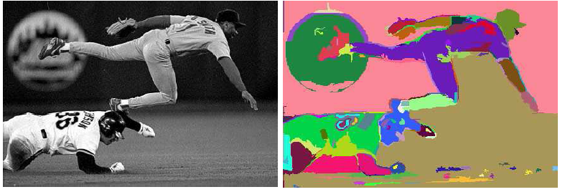
Superpixel
Pixel-wise prediction may cause noise, we can avoid it by assigning a single label to local regions of same color intensities
Felzenszwalb et al, ACM IJCV 2004
Notes:
internal difference of a component
difference between two components
A threshold function is used to control the degree to which the difference between components must be larger than minimum internal difference.

Slide 15
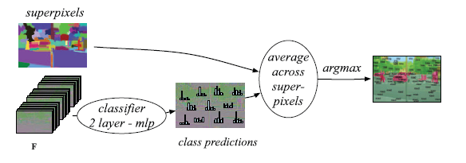
Superpixel labeling

Slide 16
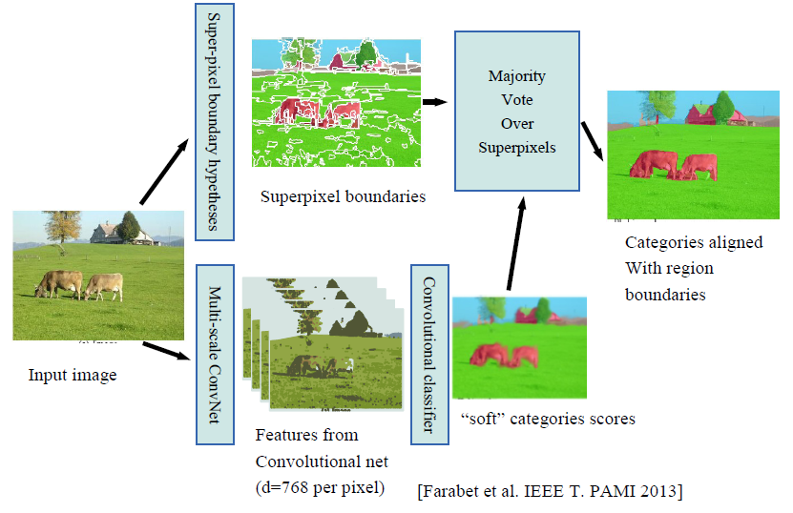
Majority over superpixel regions

Slide 17
Outline
Background/Motivation
Multiscale CNN for feature representation and initial classification
Postprocessing: Graph-based classification
Majority over super-pixel regions
CRF over superpixels
Optimal cover of purity tree
Experimental Results
Discussion

Slide 18
CRF in image labeling
Let G = (S, E) be a graph, then (X, L) is said to be a Conditional Random Field (CRF) if, when conditioned on X, the random variables obey the Markov property with respect to the graph:
where S-{i} is the set of all sites in the graph except the site i, Ni is the set of neighbors of the site i in G.
CRF
MRF
Notes:
MRF is a generative model(Two-step)
Infer likelihood and prior
Then use Bayes theorem to determine posterior
CRF is a discriminative model(One-step): Directly infer posterior

Slide 19
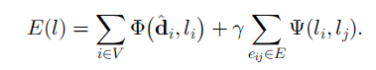
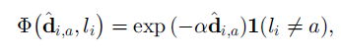
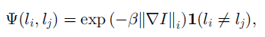
CRF over superpixel
Superpixl strategy only gives a local assignment, not involve a global understanding of the scene
This paper use a CRF to impose consistency and coherency
where
Notes:
where ^di;a corresponds to the probability of class a being present at a pixel i computed as in superpixel section
The first term is the basic loss, the second term is local consistency
Standard CRFs [11] employ two forms of feature functions, which would be defined in a 2D image as follows: state feature functions, f(li , X,i), of the label at a site i and the observed image; and transition feature functions f(li , lj , X,i), of the image and labels at site i and a neighboring site j in the image.

Slide 20
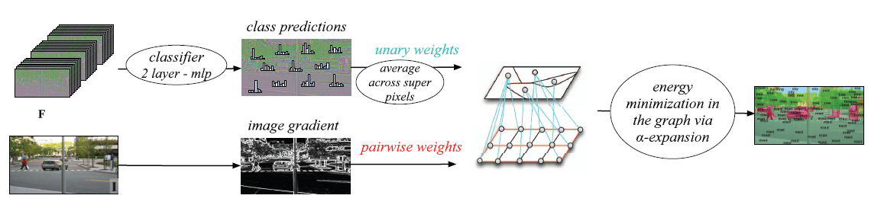
CRF over superpixels

Slide 21
Outline
Background/Motivation
Multiscale CNN for feature representation and initial classification
Postprocessing: Graph-based classification
Majority over super-pixel regions
CRF over superpixels
Optimal cover of purity tree
Experimental Results
Discussion

Slide 22
Why optimal cover of purity tree
The observation level problem: An object, or object part, can be easily classified once it is segmented at the right level.
The previous two strategies are based on an arbitrary segmentation of the image
The proposed optimal cover of purity tree can analyze a family of segmentations and automatically discover the best observation level for each pixel in the image
Notes:
The above two strategies are based on an arbitrary segmentation of the image, which typically decomposes it into segments that are too small or, more rarely, too large

Slide 23
Hierarchical segmentations
Set of components can be very large, this paper adopt hierarchical segmentations to reduce the number of components for a pixel
Hierarchical segmentations are generated by method described in [1],[2]
Transform the output of any contour detector into a hierarchical region tree.
[1]. Contour Detection and Hierarchical Image Segmentation
[2]. Geodesic Saliency of Watershed Contours and Hierarchical Segmentation

Slide 24
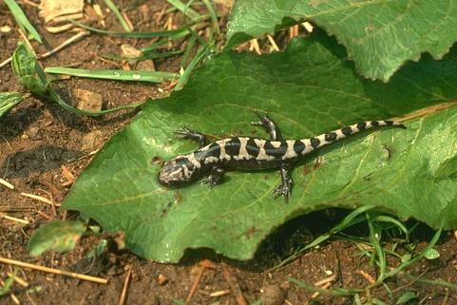
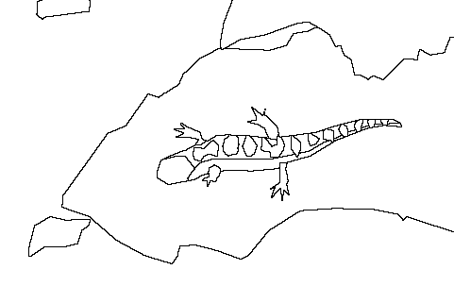
Hierarchical segmentations
Notes:
a hierarchy of segmentations that can be represented as a tree T.
Hierarchical segmentation generates a tree:
This process produces a tree of regions, where the leaves are the initial elements of P0, the root is the entire image,
and the regions are ordered by the inclusion relation.

Slide 25
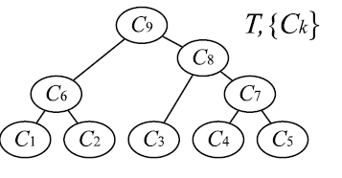
Component cover
Represent the component cover with a tree
Notes:
Hierarchical segmentation generates a tree:
This process produces a tree of regions, where the leaves are the initial elements of pixels, the root is the entire image,
and the regions are ordered by the inclusion relation.
Then the key problem is to how to measure which component is chosen: we need measurement, it is purity in a component

Slide 26
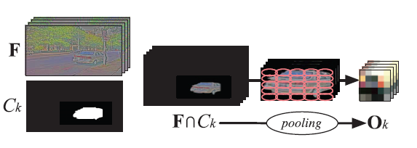
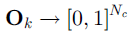
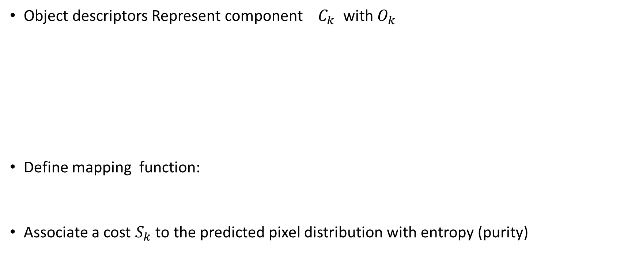
How to compute purity/Producing confidence cost
Object descriptors Represent component $C_{k}$ with $O_{k}$
Define mapping function:
Associate a cost $S_{k}$ to the predicted pixel distribution with entropy (purity)
Notes:
If we have predictions on each pixel on a component, then we can compute the entropy

Slide 27
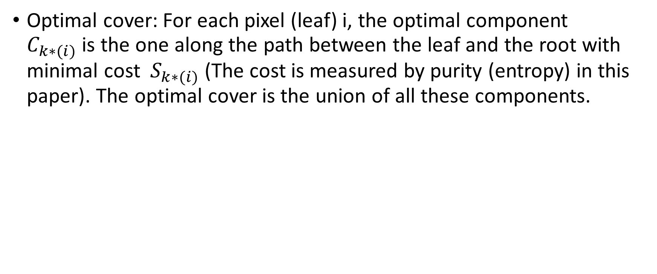
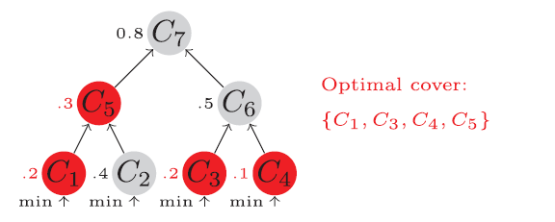
Optimal Purity Cover
Optimal cover: For each pixel (leaf) i, the optimal component $C_{k∗(i)}$ is the one along the path between the leaf and the root with minimal cost $S_{k∗(i)}$ (The cost is measured by purity (entropy) in this paper). The optimal cover is the union of all these components.
Notes:
Hierarchical segmentation generates a tree:
This process produces a tree of regions, where the leaves are the initial elements of P0, the root is the entire image,
and the regions are ordered by the inclusion relation.

Slide 28
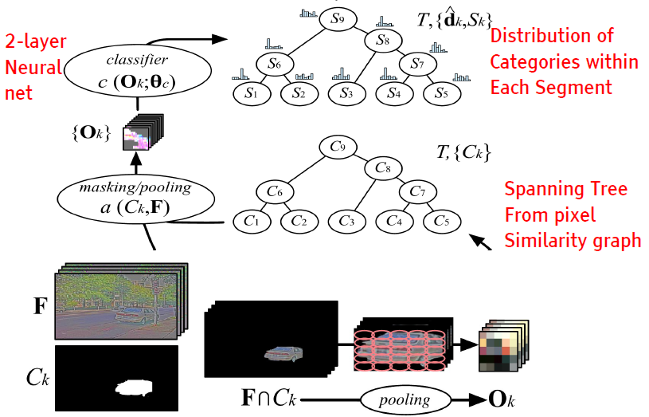
Optimal cover of purity tree
Notes:
Third labeling strategy from the features: Using a family of segmentations as described in Section 4.3. In this figure, the family of
segmentations is a segmentation tree. The segment associated with each node in the tree is encoded by a spatial grid of feature vectors
pooled in the segment’s region. A classifier is then applied to all the aggregated feature grids to produce a histogram of categories, the
entropy of which measures the “impurity” of the segment. Each pixel is then labeled by the minimally impure node above it, which is the
segment that best “explains” the pixel.

Slide 29
Proposed method revisit

Slide 30
Outline
Background/Motivation
Multiscale CNN for feature representation and initial classification
Postprocessing: Graph-based classification
Majority over super-pixel regions
CRF over superpixels
Optimal cover of purity tree
Experimental Results
Discussion

Slide 31
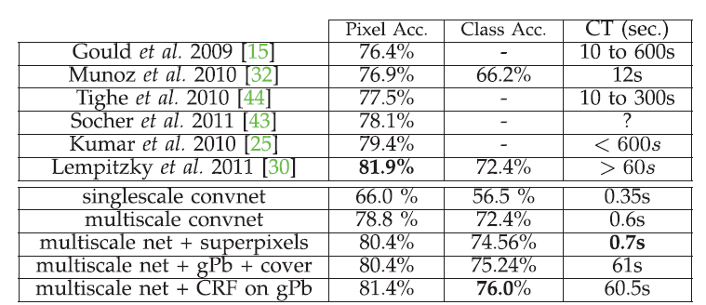
Scene parsing performance
Stanford Background Dataset [Gould 1009]: 8 categories
Notes:
Note, gpb is the name of hierarchical segmentation
Multi-scale network is much better than single-scale network
[30] is A Pylon Model for Semantic Segmentation

Slide 32
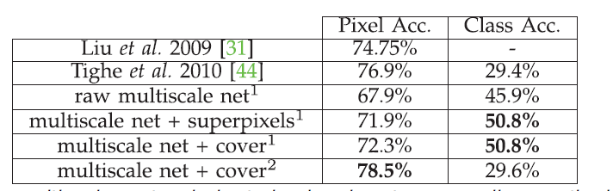
Scene parsing performance
SIFT Flow Dataset [Liu 2009]: 33 categories
Notes:
Our multiscale network is trained using two sampling methods:
1 denotes balanced frequencies, 2 notes natural frequencies. We compare the results of our multiscale network with the raw (pixelwise) classifier, Felzenszwalb et al. superpixels [11] (one level), and our optimal cover applied to a stack of 10 levels of Felzenszwalb et al. superpixels. Note: The
threshold for the single level was picked to yield the best results; the cover automatically finds the best combination of superpixels.
For the SIFT Flow and Barcelona datasets, they experimented with two sampling methods when learning the
multiscale features: respecting natural frequencies of classes, and balancing them so that an equal amount of each class is shown to the network.

Slide 33
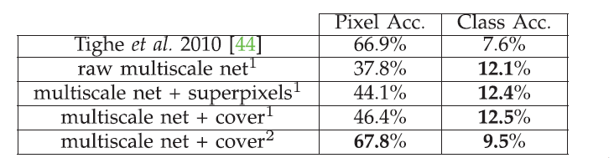
Scene parsing performance
Barcelona dataset [Tighe 2010]: 170 categories
Notes:
Our multiscale network is trained using two sampling methods: 1 balanced frequencies, 2 natural frequencies. We compare the results
of our multiscale network with the raw (pixelwise) classifier, Felzenszwalb et al. superpixels [11] (one level), and our optimal cover applied to
a stack of 10 levels of Felzenszwalb et al. superpixels. Note: The threshold for the single level was picked to yield the best results; the
cover automatically finds the best combination of superpixels.

Slide 34
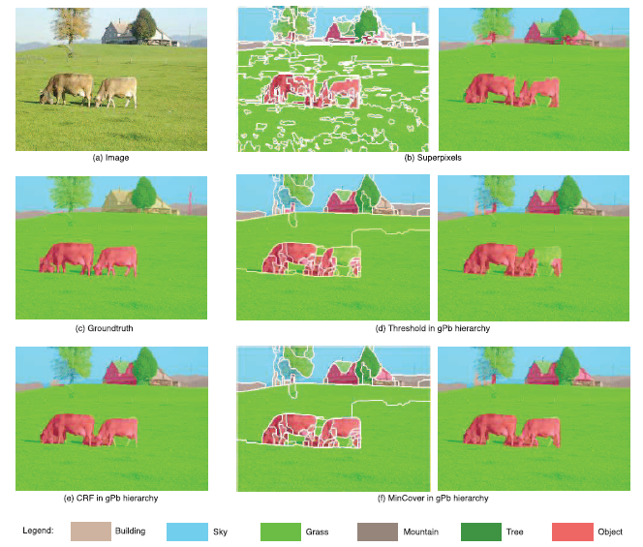
Scene parsing: Stanford dataset
Notes:
Example of results on the Stanford background dataset. (b), (d), and (f) Results with different labeling strategies, overlaid with superpixels
(see Section 4.1), segments results of a threshold in the gPb hierarchy [1], and segments recovered by the maximum purity approach with an optimal
cover (see Section 4.3). The result (c) is obtained with a CRF on the superpixels shown in (d), as described in Section 4.2.

Slide 35
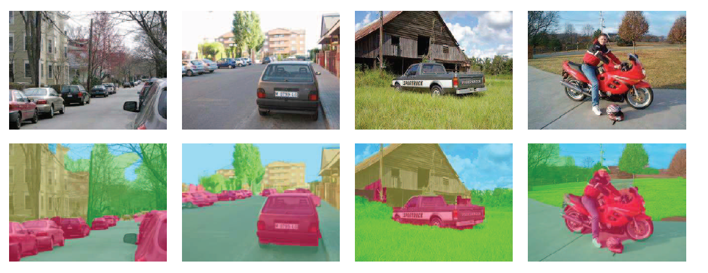
Scene parsing: Stanford dataset
Notes:
More results using our multiscale ConvNet and a flat CRF on the Stanford background dataset.

Slide 36
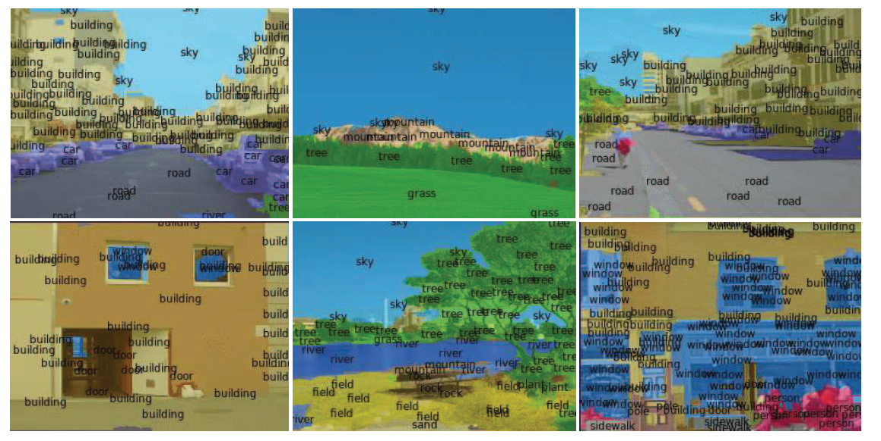
Scene parsing: SIFT flow dataset
Notes:
Typical results achieved on the SIFT Flow dataset.

Slide 37
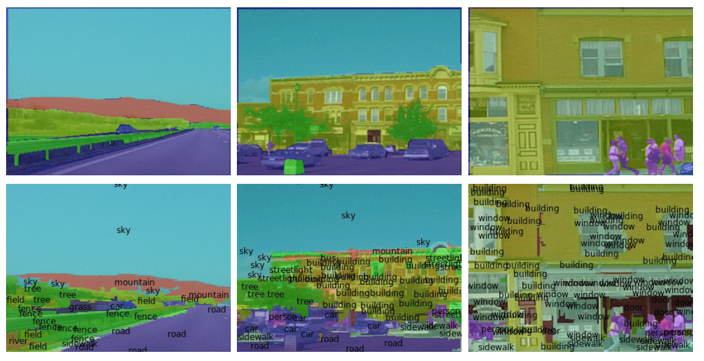
Scene parsing: SIFT flow dataset

Slide 38
Scene parsing: real time
From url:
http://www.clement.farabet.net/research.html#parsing

Slide 39
Outline
Background/Motivation
Multiscale CNN for feature representation and initial classification
Postprocessing: Graph-based classification
Majority over super-pixel regions
CRF over superpixels
Optimal cover of purity tree
Experimental Results
Discussion

Slide 40
Discussion
Wide contextual window is critical to the quality of scene parsing
When a wide context is used, postprocessing is greatly reduced
Notes:
1. Feeding the system with a wide contextual window
is critical to the quality of the results. The numbers in
Table 1 show a dramatic improvement in the
performance of the multiscale ConvNet over the
single scale version.

Slide 41
Discussion
Highly complicated postprocessing schemes do not seem to improve the results significantly over simple schemes
Notes:
3. This seems to suggest that the performance is limited by the quality of the labeling or the quality

Slide 42
Discussion
The proposed feed-forward pixel labeling system is dramatically faster
Notes:
4. This is demonstrated by the FPGA implementation [9], [10] of the feature
extraction scheme presented in this paper that runs in 60 ms for an image resolution of 320x240.
of the segmentation hypotheses, rather than by the quality of the contextual consistency system or the inference algorithm.

Slide 43
Thank you

